Slide 1
L
3) Response: changed rotation direction
1) Stimulus: ligand
L
L
L
L
Extracellular Space
Receptor
Cellular membrane
Chesson P.. Mechanisms of maintenance of species diversity. Annu Rev Ecol Evol Syst 31: 343-366 https://journals.plos.org/ploscompbiol/article?id=10.1371/journal.pcbi.1008010
Cytoplasm
CW rotation
2) Signaling Events

Slide 2
1) Stimulus: ligand
L
3) Response: changed rotation direction
L
L
Extracellular Space
MCP
Cellular membrane
Chesson P.. Mechanisms of maintenance of species diversity. Annu Rev Ecol Evol Syst 31: 343-366 https://journals.plos.org/ploscompbiol/article?id=10.1371/journal.pcbi.1008010
Cytoplasm
CW rotation
CheW
P
CheA
P
CheY
CheZ
ATP
ADP
CheY
P
2) Signaling Events

Slide 3
L
L
L
Extracellular Space
MCP
Cellular membrane
Chesson P.. Mechanisms of maintenance of species diversity. Annu Rev Ecol Evol Syst 31: 343-366 https://journals.plos.org/ploscompbiol/article?id=10.1371/journal.pcbi.1008010
Cytoplasm
+CH₃
CheR
CheW
-CH₃
P
CheA
P
CheB
ATP
ADP
P
CheB

Slide 4
L
Stimulus: ligand
L
Response
L
Extracellular Space
MCP
Cellular membrane
+CH₃
Cytoplasm
CheR
CheW
CW rotation
-CH₃
P
CheA
P
P
CheY
CheB
CheZ
ATP
ADP
P
CheB
CheY
P
Adaptation
Initially: Feed-forward

Slide 5

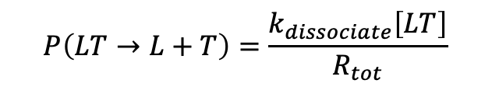
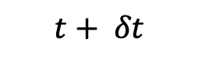
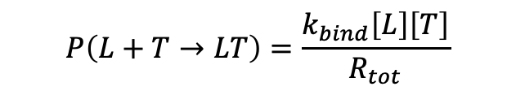
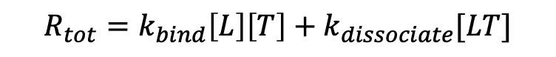
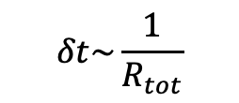
$$R_{tot}=k_{bind}\left[L\right]\left[T\right]+k_{dissociate}[LT]$$
L
L
Receptor
Receptor
$$P\left(LT→L+T\right)=\frac{k_{dissociate}\left[LT\right]}{R_{tot}}$$
Receptor
L
L
L
Receptor
Receptor
Receptor
L
L
$$P\left(L+T→LT\right)=\frac{k_{bind}\left[L\right]\left[T\right]}{R_{tot}}$$
L
Receptor
Receptor
L
Receptor
$$δt\sim \frac{1}{R_{tot}}$$
$$t$$
$$t+ δt$$

Slide 6
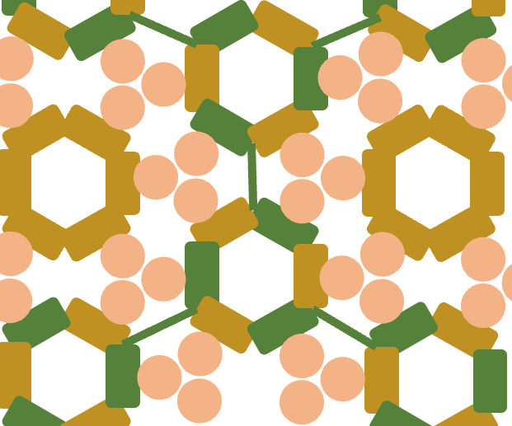
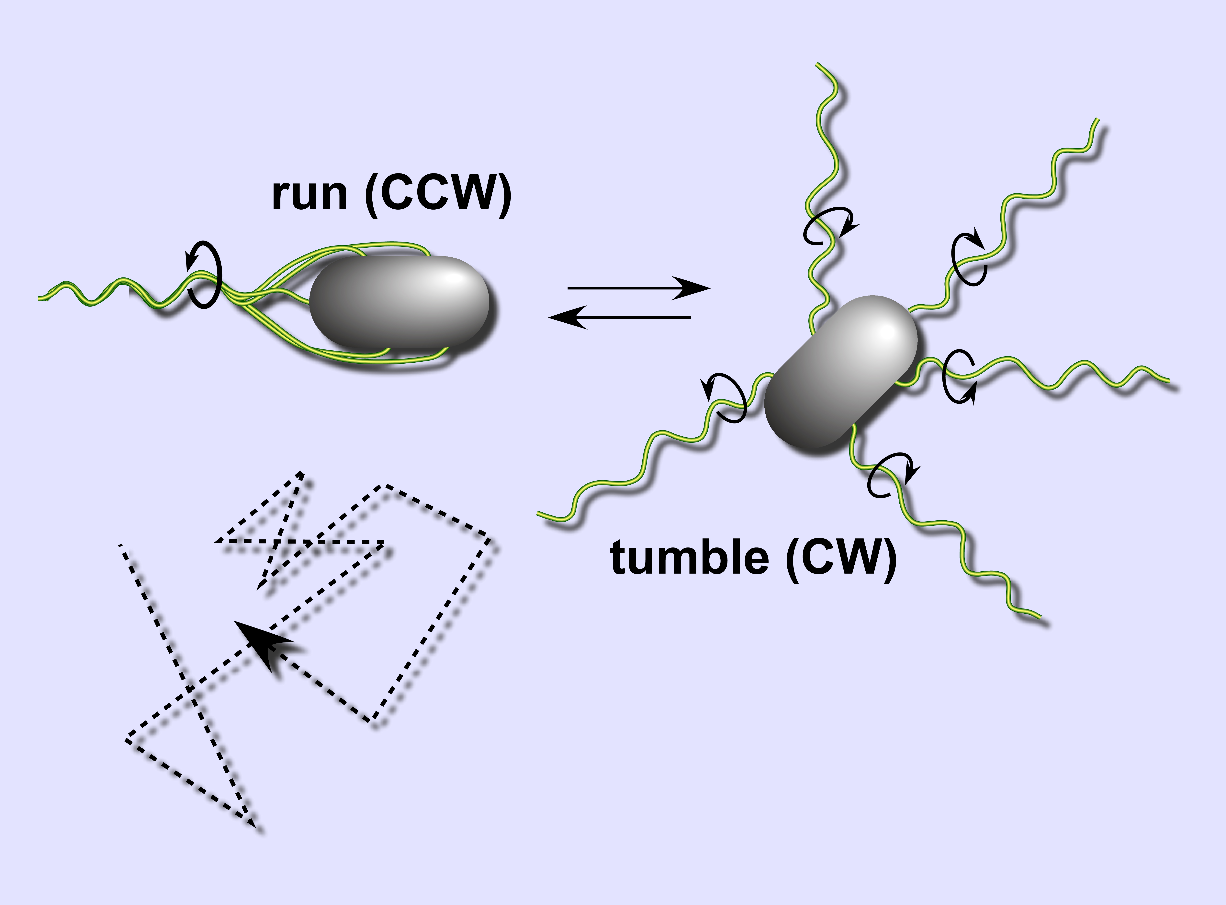
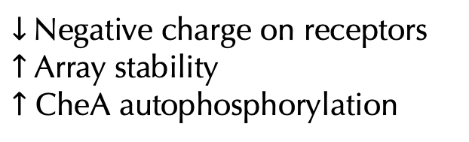

+CH₃
$↓$ Negative charge on receptors
$↑$ Array stability
$↑$ CheA autophosphorylation
$↑$ CheY phosphorylation
$↑$ Tumbling frequency
+CH₃
CheW
CheA
MCP
MCP
MCP
MCP
MCP
MCP
CheA
CheW

Slide 7
Scratch, please ignore
CheW
CheA
MCP
MCP
MCP
MCP
MCP
MCP
CheA
CheW

